Slide 1

Matching Product Names with Enhanced Similarity Algorithms
Using NLP and Machine Learning Techniques.
Presented by Malak Alabiad.

Slide 2
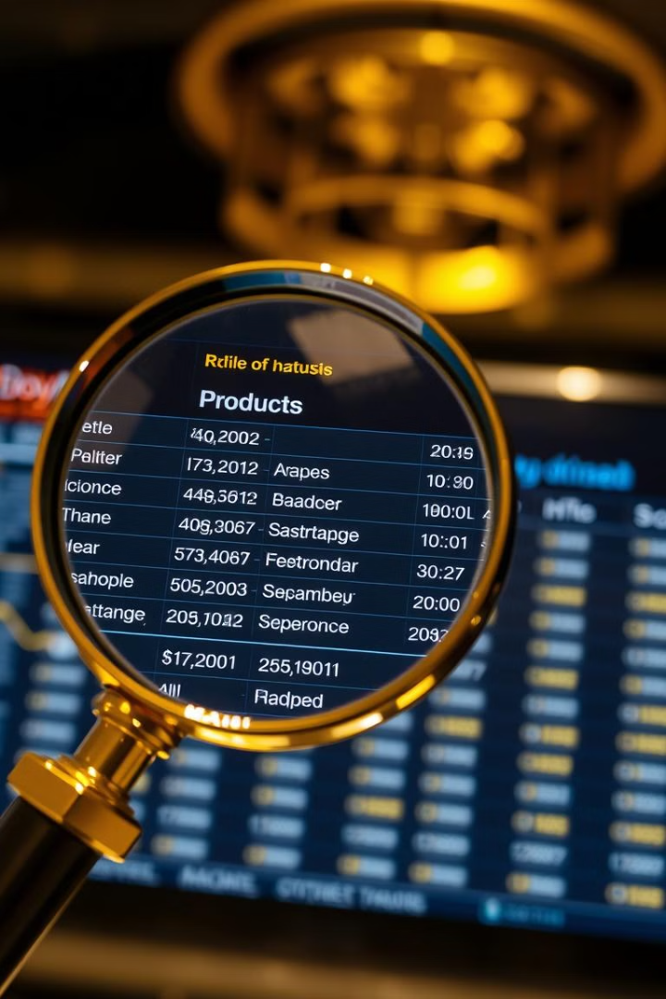
Identifying Matching Products
1
Objective
Match seller product names to master product names.
2
Challenge
Variations in language, abbreviations, and formats.

Slide 3

Solution Overview
Text Preprocessing
Similarity Measures
Use NLP and similarity algorithms.
Apply cosine similarity, fuzzy matching, and Levenshtein distance.
Accurate Match
Combine multiple similarity measures.

Slide 4

Data Loading
1
Load Data
Load dataset and master file from Excel.
2
Drop Duplicates
Remove duplicates from the dataset.
3
Export to CSV
Export both files to CSV.

Slide 5




Text Preprocessing (Part 1)
Convert to Lowercase
Convert text to lowercase.
Remove Diacritics
Remove Arabic diacritics.
Expand Abbreviations
Expand common abbreviations.

Slide 6



Text Preprocessing (Part 2)
Normalize Spaces
2
Normalize spaces.
Remove Punctuation
1
Remove punctuation.
NLTK Stopwords
3
Use NLTK stopwords.

Slide 7
Dosage and Form Extraction
Dosage Extraction
Form Extraction
Extract dosage from product names.
Extract form from product names.

Slide 8
Similarity Calculation Components
Cosine Similarity
1
Compares text vectors.
Fuzzy Matching
2
Token-based similarity.
Levenshtein Distance
3
Measures string edit distance.

Slide 9



Similarity Calculation - Fuzzy and Levenshtein
Fuzzy Matching
Levenshtein Ratio
Extract best match.
Calculate ratio of edits.

Slide 10
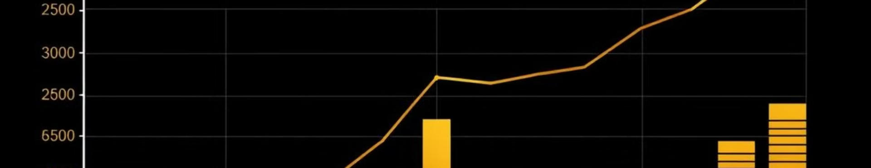
Combined Score Calculation
0.4
0.25
Cosine Weight
Fuzzy Weight
Weight for cosine similarity.
Weight for fuzzy score.

